Slide 1




NEXT GEN EMPLOYABILITY PROGRAM
Creating a future-ready workforce
Team Members
College Name
Student Name :VARSHA V
Student ID : 311121104062
Loyola ICAM College of Engineering and Technology

Slide 2

CAPSTONE PROJECT SHOWCASE
Project Title
Music Web Application using Django Framework
Abstract | Problem Statement | Project Overview | Proposed Solution | Technology Used | Modelling & Results | Conclusion

Slide 3
Abstract
This project entails the creation of a music platform using Django. The platform will empower users to register accounts, curate their music collections, and enjoy seamless music streaming. Prominent features encompass user verification, an adaptable user interface, encrypted file storage, and an interactive music player interface. Moreover, the platform will leverage Django's integrated ORM for efficient database administration and RESTful APIs to seamlessly amalgamate with frontend technologies.
Source :

Slide 4
Problem Statement
Creation of Music Web Application using Django Framework
Source :

Slide 5
Project Overview
This project endeavors to build a contemporary and intuitive music streaming platform utilizing Django. The platform will empower users to establish customized accounts, organize their music libraries, and indulge in uninterrupted streaming of their preferred tunes. Noteworthy features encompass user verification, adaptable design catering to diverse devices, encrypted file storage, and an instinctive music player interface. By harnessing Django's ORM capabilities and RESTful APIs, our objective is to furnish a dependable platform that elevates the music listening journey for all users.
Source :

Slide 6
Proposed Solution
.
Our endeavor entails crafting a music streaming platform utilizing Django, integrating vital functionalities such as user authentication, music upload and administration, and a dynamic music player. We'll deploy secure file storage mechanisms for user uploads and ensure cross-device compatibility through responsive design techniques. Employing Django's ORM capabilities will streamline database management, while the adoption of RESTful APIs will foster smooth communication with the frontend. Our objective is to establish a seamless and gratifying music streaming experience, prioritizing ease of use and practicality.
Source :

Slide 7


Technology Used
Front-end
Back-end
Source :

Slide 8
Modelling & Results
The project will encompass formulating a Django data schema to depict users, music compositions, and playlists. Through Django's ORM, we'll ensure adept data storage and retrieval mechanisms. User validation will be orchestrated leveraging Django's inherent authentication framework. On the frontend, we'll craft responsive templates employing HTML, CSS, and JavaScript to facilitate seamless user engagement. Music streaming functionality will be realized through Django's file management features alongside a tailor-made music player interface.
Source :

Slide 9
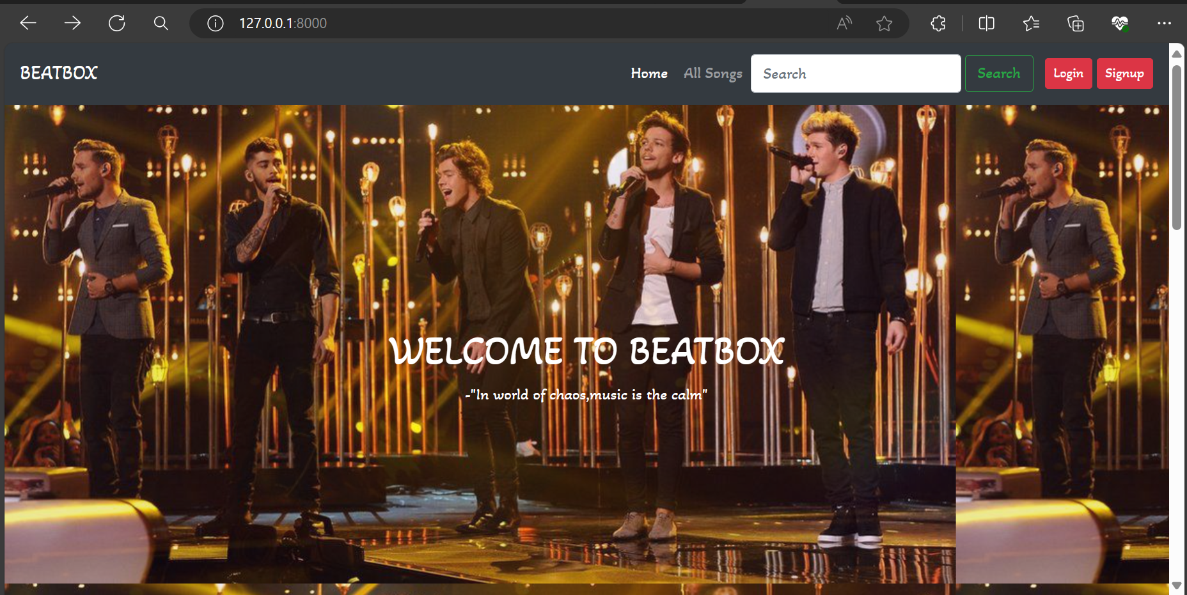
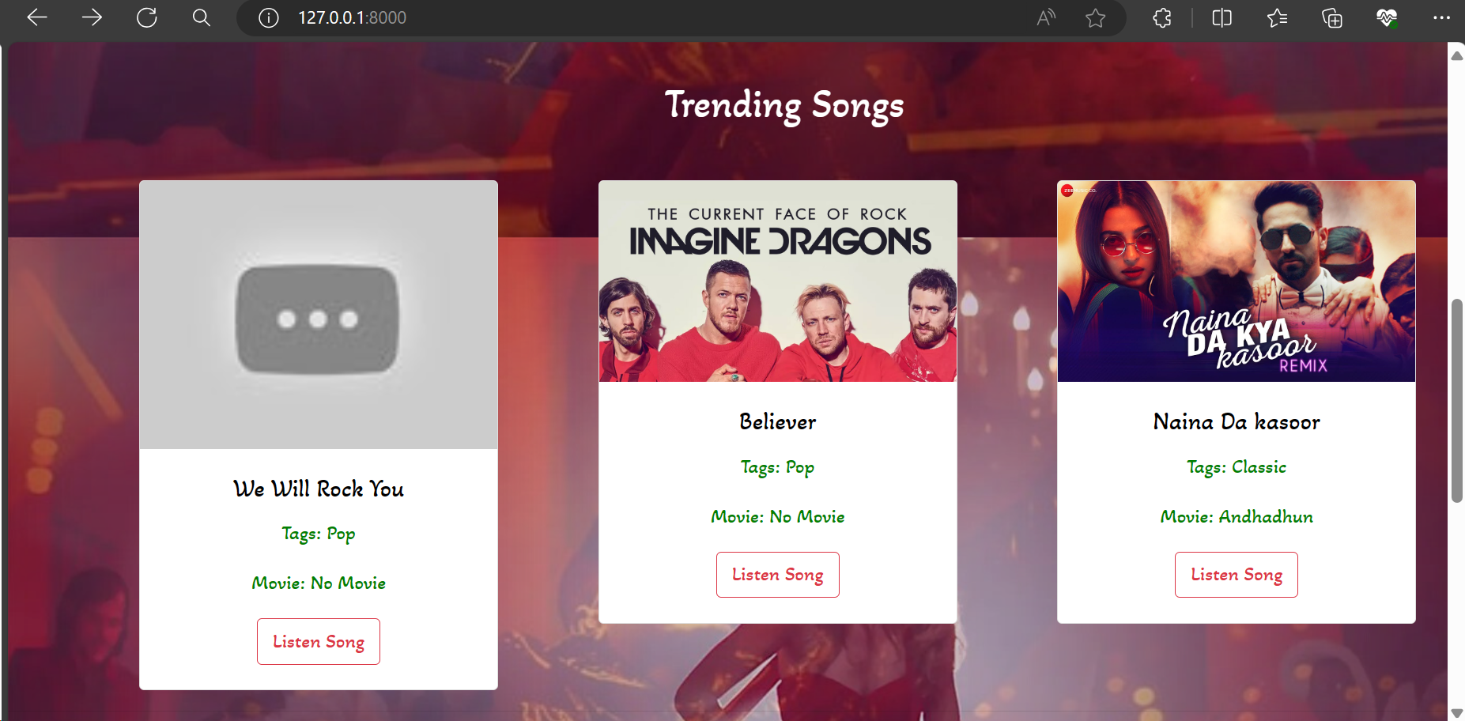
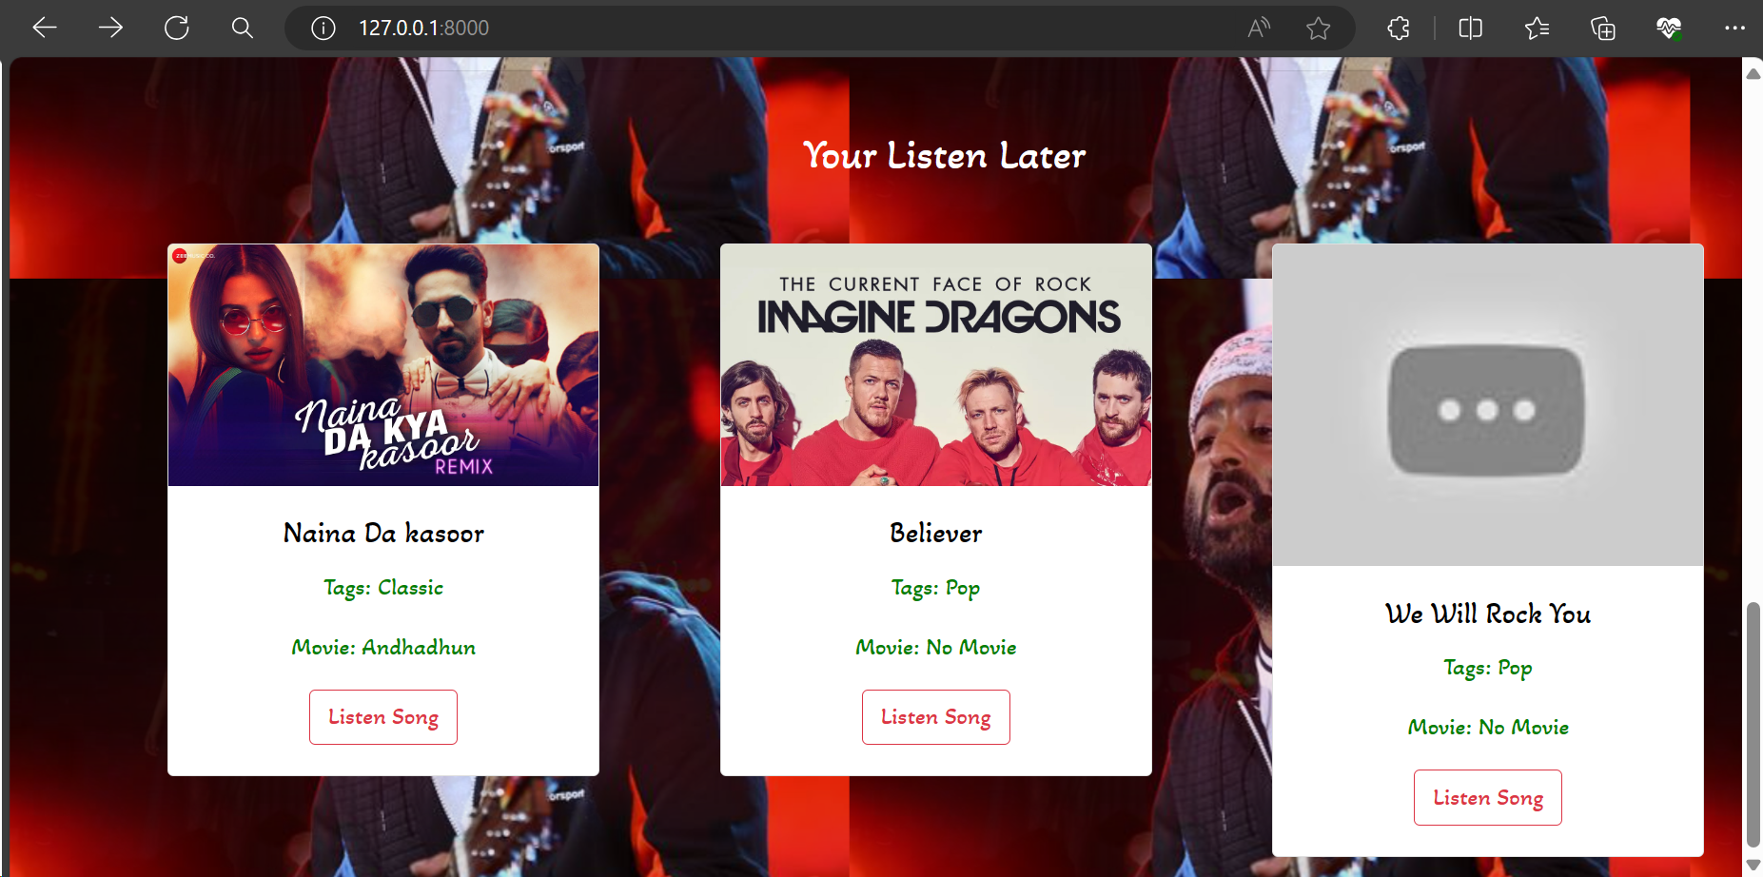
Homepage

Slide 10
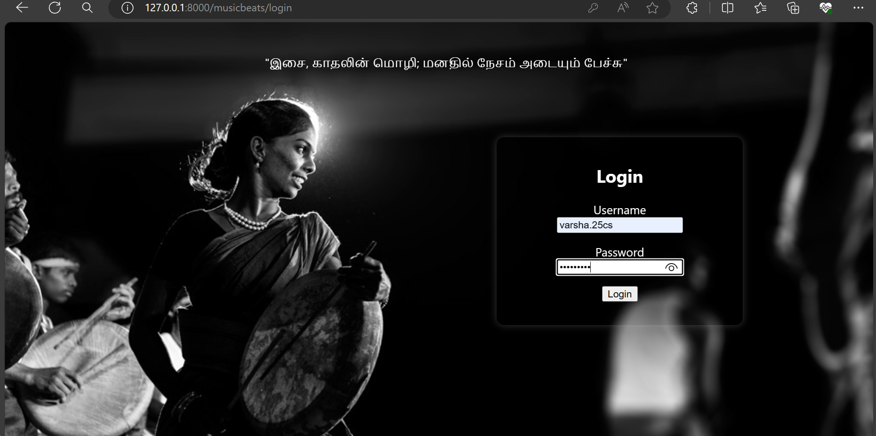
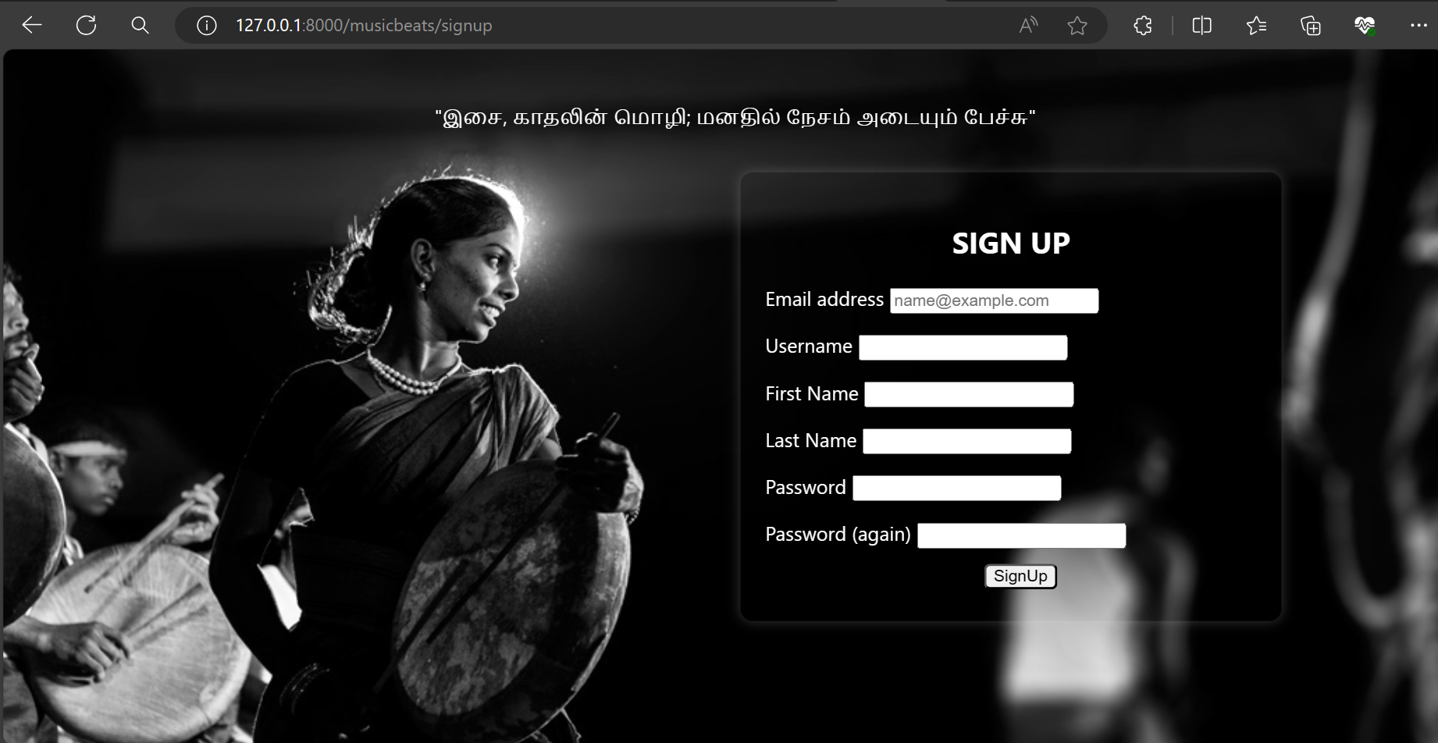
Login and Sign Up

Slide 11
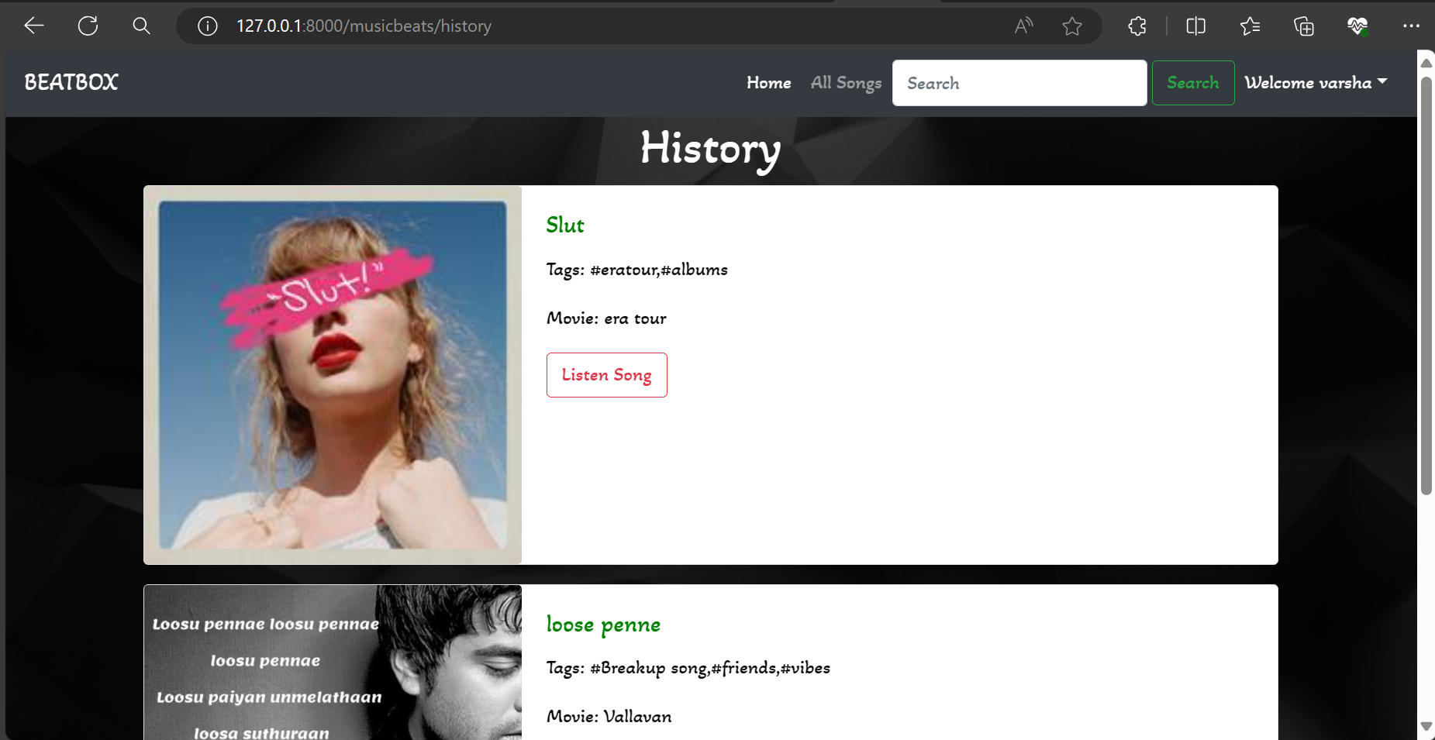
History

Slide 12
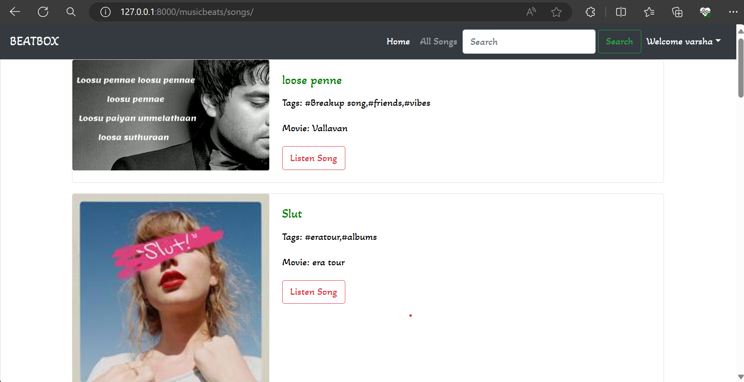
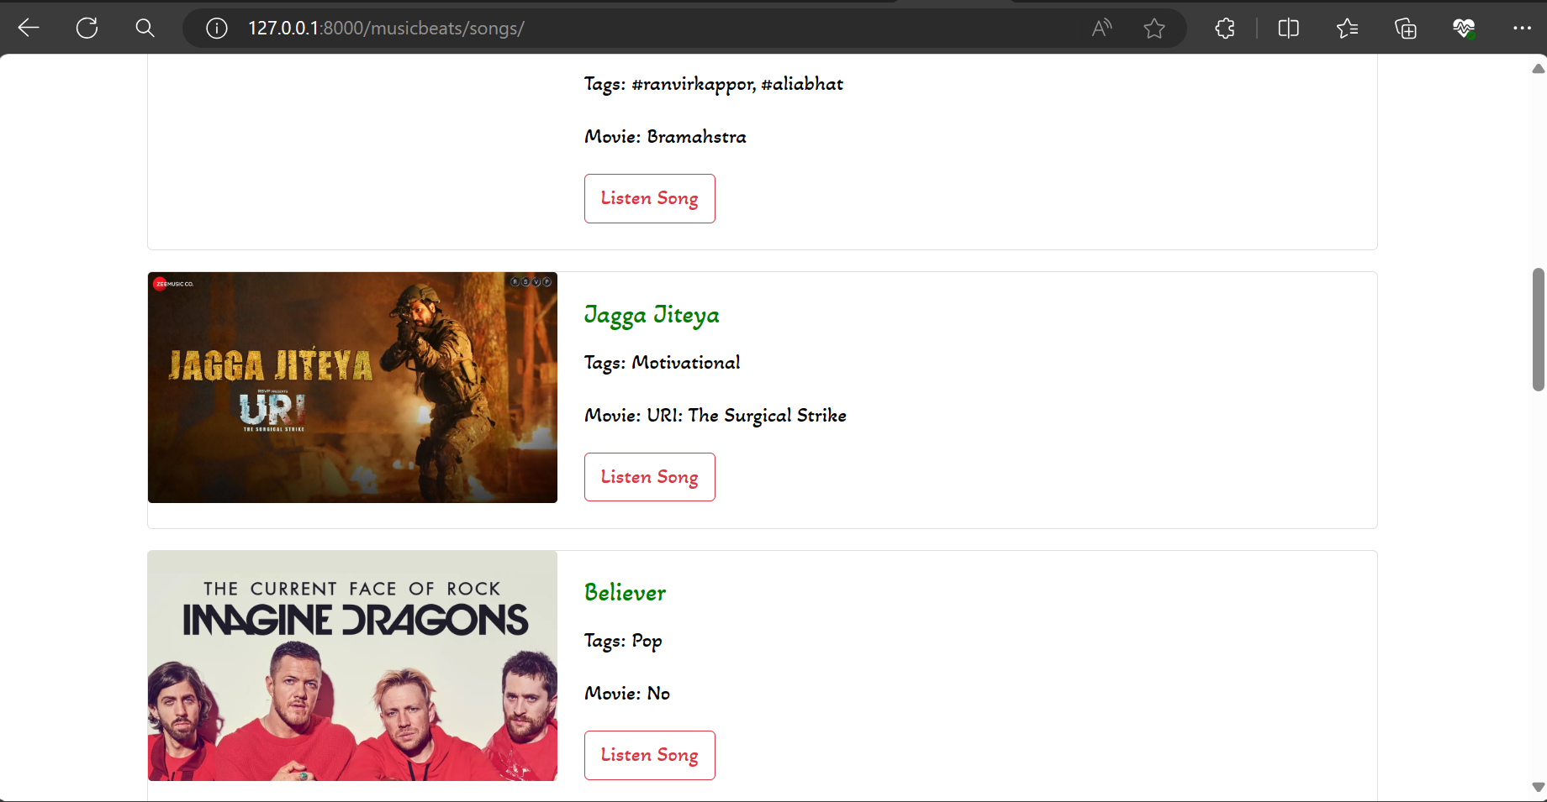
All Songs

Slide 13
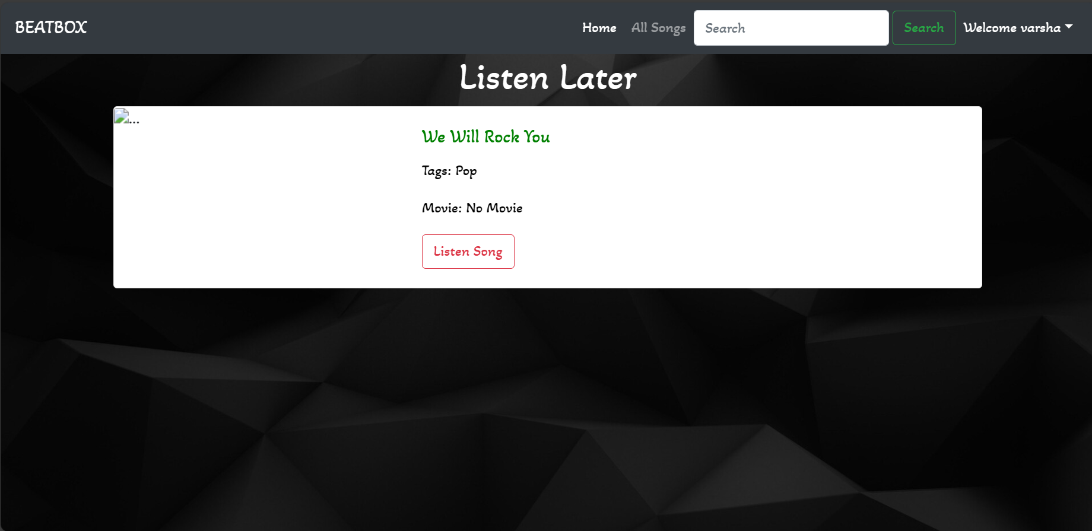
Listen Later

Slide 14
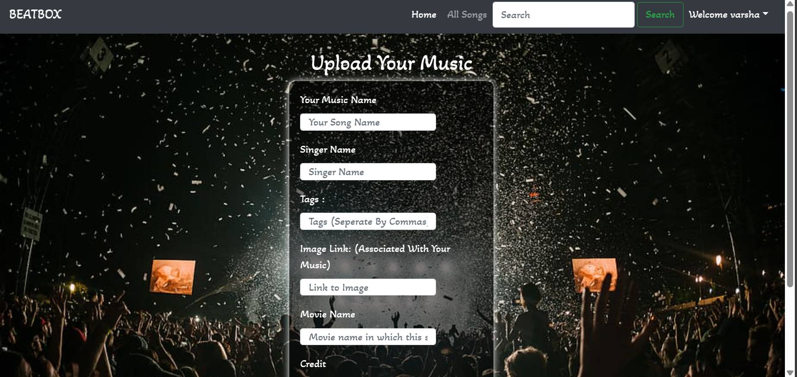
Playlist Upload

Slide 15
Future Enhancements:
Moving forward, potential enhancements could include integrating personalized recommendations derived from user listening patterns, enabling social sharing of playlists, and integrating external music APIs for broader content access. Additionally, supporting offline playback and enriching the user interface with interactive elements could enhance user experience. Continuous efforts towards performance optimization and scalability enhancements will be crucial to accommodate a growing user base.

Slide 16
Conclusion
To summarize, the Django-powered music streaming application offers a scalable and comprehensive platform tailored for music enthusiasts. Utilizing Django's robust framework, I've crafted a responsive and secure solution that prioritizes user satisfaction. With ongoing development and planned future enhancements, we are dedicated to evolving the application to adapt to the evolving landscape of music streaming, ensuring a seamless and delightful experience for our users.
Source :

Slide 17
Thank You!
Notes:
Thank You !!

